Slide 1
Transforming Lives Through Sweet Potato Farming in Migori, Kenya
A Data-Driven Approach to Solving Hunger
Name: Kevien Otieno Mulambe
Date: September 2024

Slide 2
Overview
SDG 2, Zero Hunger, aims to end hunger, achieve food security, and promote sustainable agriculture by 2030. This goal focuses on providing access to nutritious food, especially for vulnerable communities, and enhancing food production through sustainable practices.
Why addressing hunger in rural areas is crucial: In rural regions like Migori, Kenya, hunger and malnutrition are pervasive due to poor agricultural yields, limited access to modern farming techniques, and lack of investment in rural economies. Solving hunger here will not only improve lives but will also stimulate economic development.
Role of agriculture: Agriculture is central to this goal, as most rural livelihoods depend on farming. By improving farming practices and using data-driven solutions, we can make farming more efficient and productive, reducing hunger significantly.

Slide 3
Hunger and Food Insecurity in Migori
In Migori, the community faces chronic hunger and food insecurity. Many smallholder farmers rely on traditional farming methods, which often lead to poor yields, low income, and limited food availability.
Challenges:
Low crop yields: Farmers face challenges such as poor soil, irregular weather patterns, and lack of knowledge about modern farming techniques, resulting in low yields.
Inefficient farming practices: Without data to guide planting, harvesting, and selling decisions, farmers cannot optimize their output.
Lack of data-driven decisions: The absence of a structured approach to track and analyze farming data results in missed opportunities for improving yields and distribution.
Impact on families and the economy: Food insecurity leads to malnutrition, poverty, and a reduced capacity to generate income. It has long-term implications for education, health, and economic growth in the region.

Slide 4
Data-Driven Sweet Potato Farming
This project aims to leverage data to optimize sweet potato farming in Migori, Kenya. By collecting and analyzing farming data (on crop yields, sales, and distribution), farmers can make informed decisions to improve production efficiency and profitability.
Data is collected on farming activities such as:
Farming Activities: Time of planting, fertilizer use, etc.
Crop Yields: Amount harvested per acre.
Sales: Revenue generated from selling the sweet potatoes.
Distribution: How crops are transported and sold in the local market or beyond.
This project directly addresses SDG 2 by enhancing farming efficiency and improving food availability, helping to alleviate hunger and food insecurity.

Slide 5
ERD and Schema Overview
ERD (Entity-Relationship Diagram): The ERD represents key entities (farmers, crops, harvests, sales, and distributions) and their relationships. Entities:
Farmers – Farmer ID, Name, Location, Contact Information.
Crops – Crop ID, Crop Name (Sweet Potatoes), Planting Date, Expected Harvest Date.
Harvests – Harvest ID, Crop ID, Farmer ID, Harvest Quantity (Kg), Harvest Date.
Sales – Sale ID, Harvest ID, Sale Quantity, Sale Price, Buyer Name, Sale Date.
Distribution – Distribution ID, Sales ID, Destination, Distribution Date.
With the relational database in place, farmers can easily track their performance, manage their resources, and make data-driven decisions on crop planting, harvesting, and selling.

Slide 6
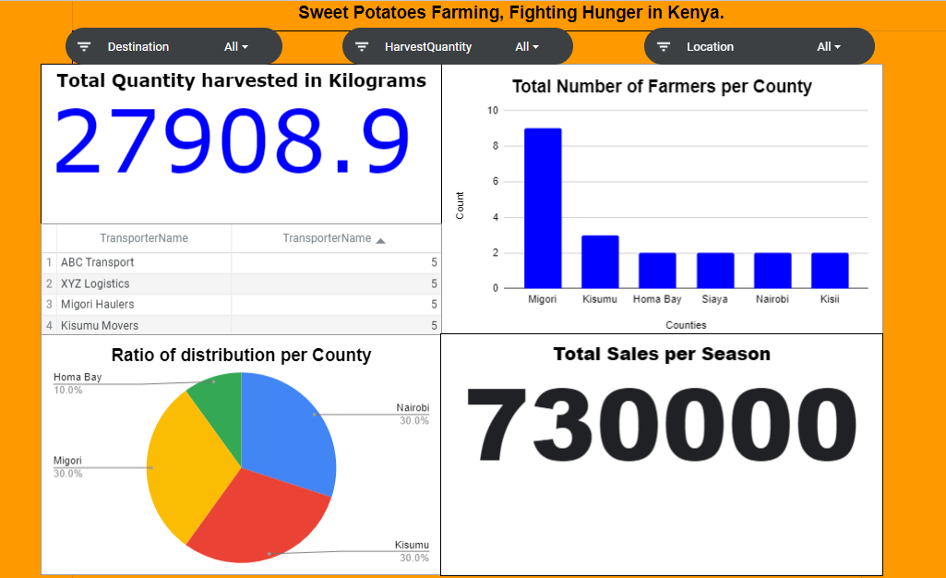
Dashboard
Notes:
From the dashboard we can note that:
The total quantity of Sweet potatoes Harvested is 27908.9Kg
Most farmers come from Migori County. We have 4 Distributors in our service. Homa Bay receives the least percentage of Sweet Potatoes after Harvest. We made a total of 730, 000 Ksh for this Season.

Slide 7
Reducing Hunger with Data-Driven Decisions
Improving crop yields: By using data on past performance, farmers can optimize planting schedules, improve soil use, and apply fertilizers more effectively.
Increasing food availability: Higher yields mean more sweet potatoes are available for sale and consumption, directly contributing to hunger reduction.
Economic and social impact:
Economic: Higher yields and more efficient sales mean higher incomes for farmers.
Social: Food security leads to better health outcomes, less malnutrition, and stronger communities.

Slide 8
Future Improvements – Scaling to Other Regions
The success of this project in Migori can be replicated in other regions across Kenya and even Africa.
Additional data integration:
Weather patterns: Tracking local weather can help predict the best times to plant.
Soil health: Adding data on soil quality could help farmers improve crop yields.
Market prices: Real-time data on market prices would allow farmers to sell their crops at the most profitable times.
The project aims to create a sustainable, data-driven approach to farming that can be scaled globally to reduce hunger.

Slide 9
Conclusion
Data-driven farming can make a significant impact on hunger in rural areas. By using modern technologies and structured data analysis, farmers can make informed decisions that improve crop yields and food security.
Next steps:
Expanding the database
Partnering with local farmers

